Slide 1
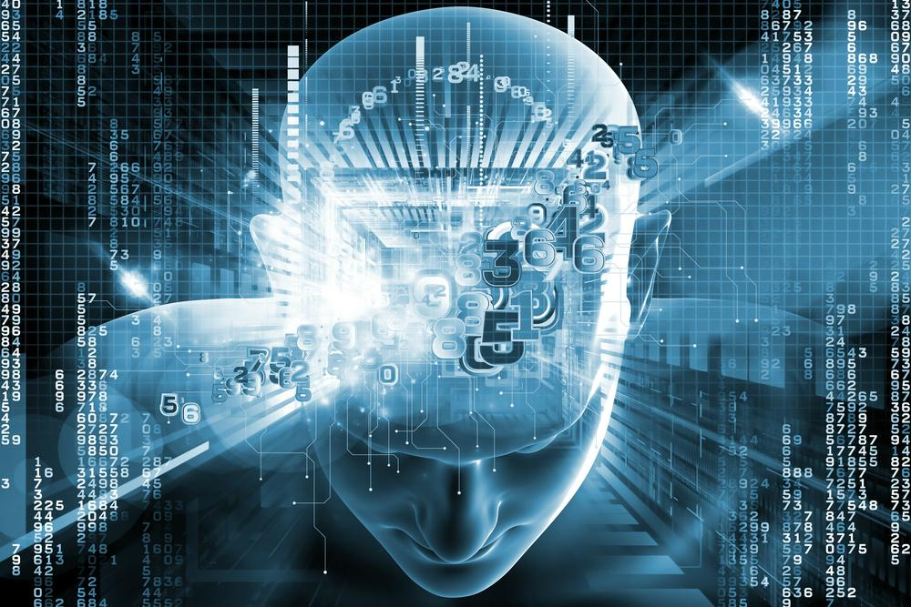

Slide 2
Artificial Intelligence and Data Science
人工智能和数据科学

Slide 3
作者简介：
姓名：王冲野
部门：公安事业部
出生日期：1998-08-20
学校：现就读于美国伊利诺伊大学香槟分校
专业：计算机&统计
研究领域：人工智能, 机器学习, 文本挖掘, 推荐系统, 数值分析
邮箱：wangchongye@hikvision.com.cn wangchonge@126.com

Slide 4
Why?

Slide 5
Because We are entering the era of big data
这是一个数据时代

Slide 6
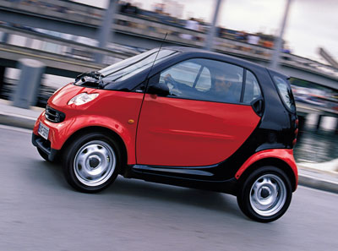

Slide 7
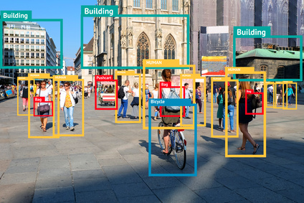

Slide 8
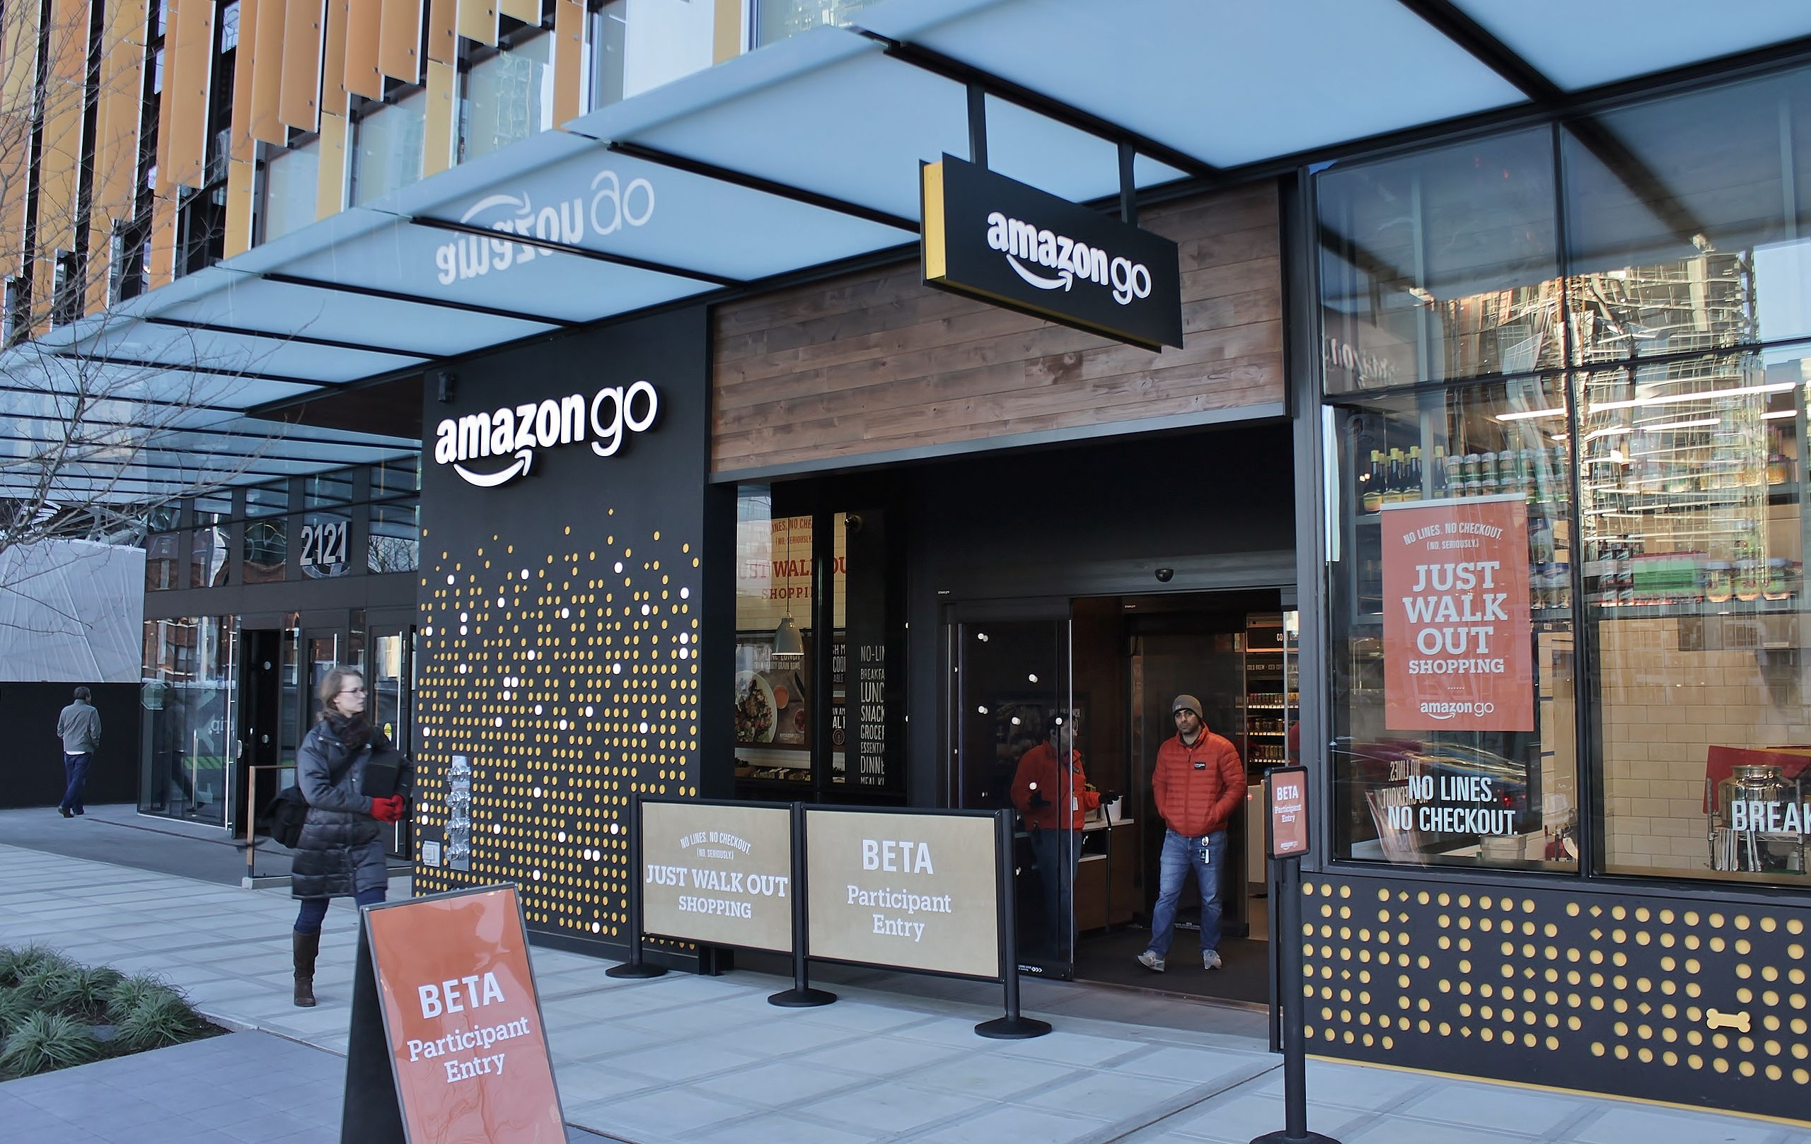

Slide 9


Slide 10


Slide 11
What is artificial Intelligence 什么是人工智能？
Artificial intelligence (AI), sometimes called machine intelligence, is intelligence demonstrated by machines in contrast to the natural intelligence displayed by humans and other animals.
---wikipedia
人工智能（英语：artificial intelligence，缩写为 AI）亦稱機器智能，指由人製造出來的機器所表現出來的智能。通常人工智能是指通過普通電腦程式的手段實現的人類智能技術。該詞也指出研究這樣的智能系統是否能夠實現，以及如何實現科學領域。同時如此，人類的數量開始收斂及功能逐漸被其取代。
---维基百科

Slide 12
The theory and development of computer systems able to perform tasks that normally require human intelligence, such as visual perception, speech recognition, decision-making, and translation between languages.

Slide 13
What is Data Science 什么是数据科学
Data science is an interdisciplinary field that uses scientific methods, processes, algorithms and systems to extract knowledge and insights from data in various forms, both structured and unstructured, similar to data mining.
---wikipedia

Slide 14
Relation between artificial intelligence and data science 人工智能和数据科学的关系

Slide 15
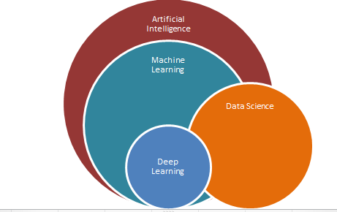

Slide 16
Machine Learning 机器学习
Text Retrieval 文本检索
Natural Language Processing 自然语言处理
Voice Recognition 语音识别
Data Mining 数据挖掘
Computer Vision 计算机视觉
Reinforcement Learning 强化学习
Recommender System 推荐系统
Deep Learning and Neural Network 深度学习和神经网络

Slide 17
MACHINE LEARNING 机器学习

Slide 18

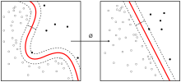
What is machine learning 什么是机器学习
Machine learning is a subset of artificial intelligence in the field of computer science that often uses statistical techniques to give computers the ability to “learn” (i.e., progressively improve performance on a specific task) with data, without being explicitly programmed.
---wikipedia

Slide 20
机器学习和人工智能的关系： 机器学习是实现人工智能的方法

Slide 21
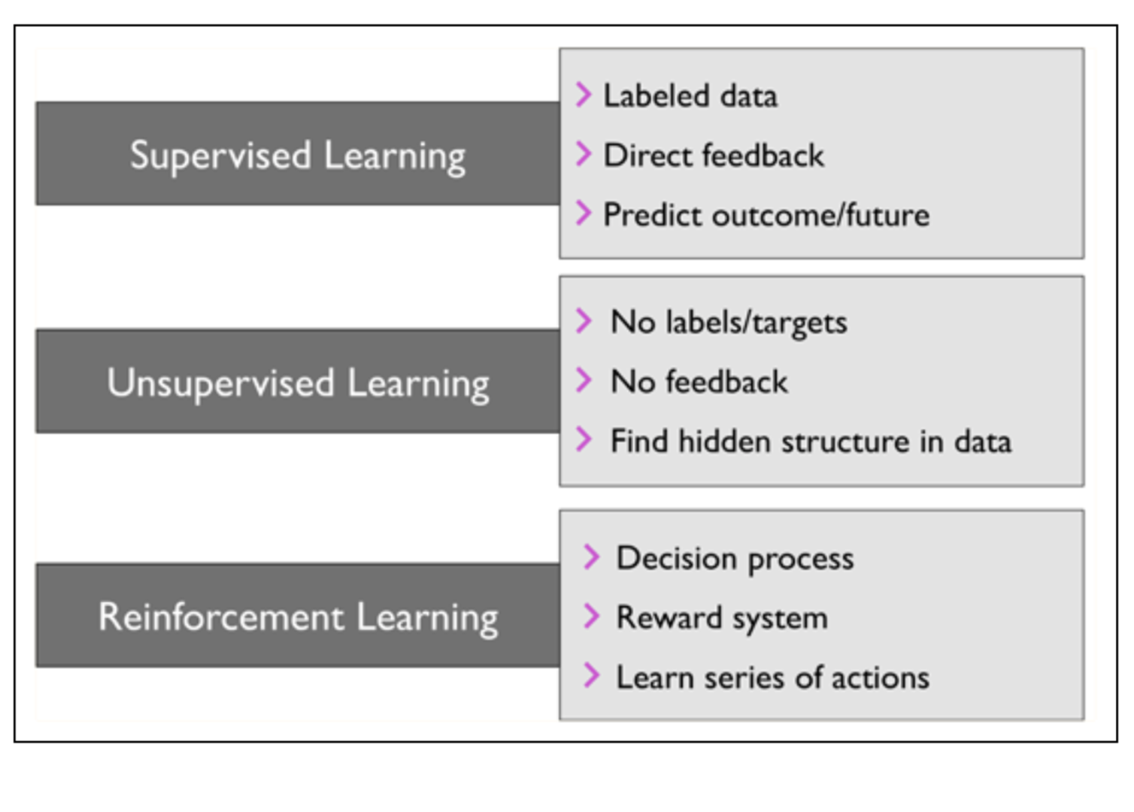

Slide 22
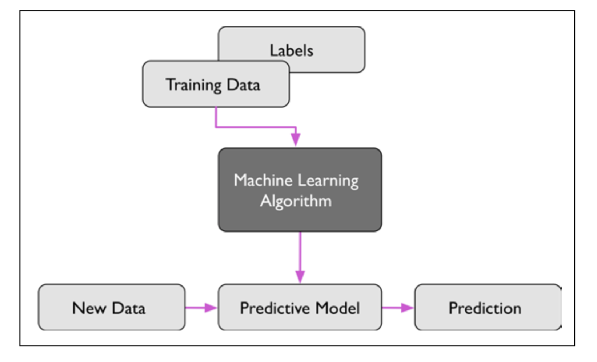
supervised learning 监督学习

Slide 23
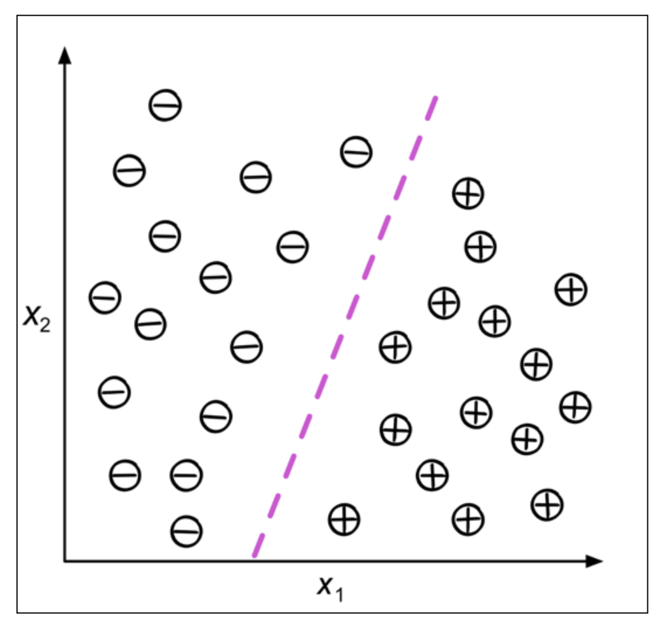

Slide 24
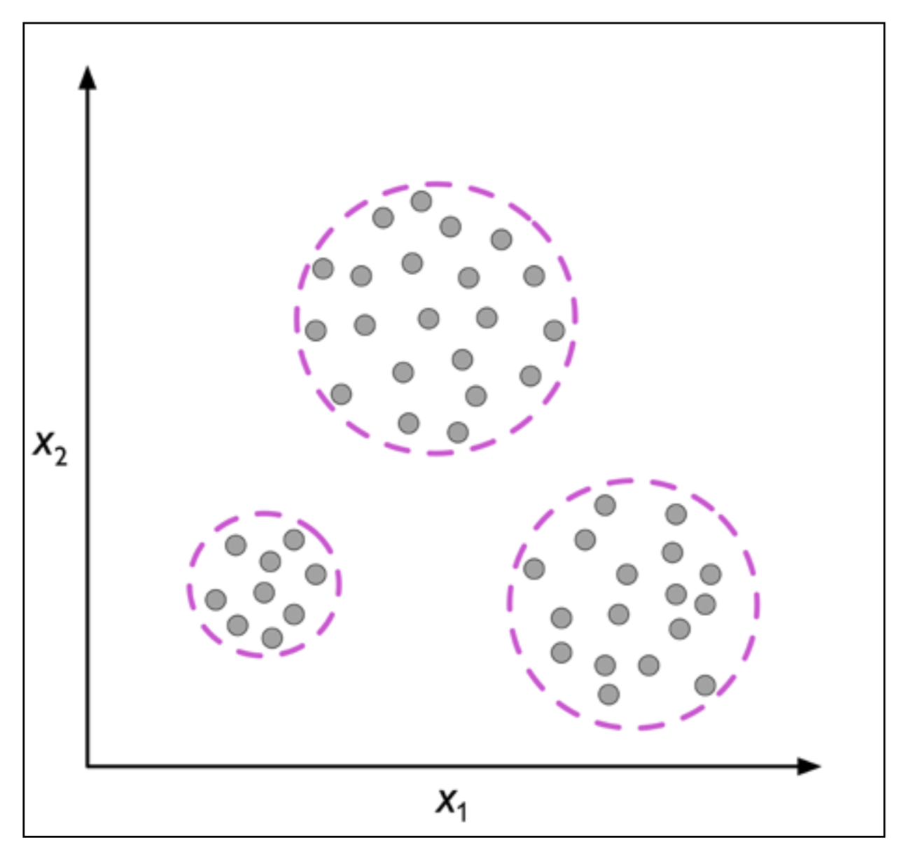
Unsupervised learning 非监督学习

Slide 25
Machine learning Python demo

Slide 26
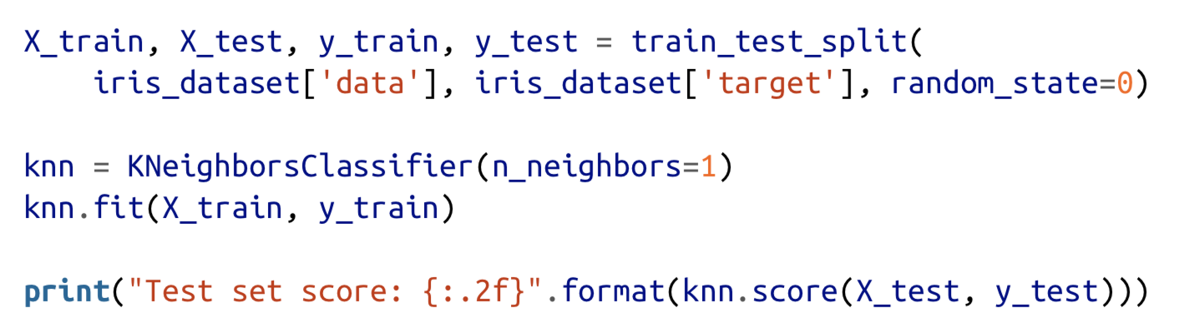

Slide 27
Text retrieval 文本检索

Slide 28
Why
Text (natural language) is the most natural way of encoding human knowledge.
Text is by far the most common type of information encountered by people.
Text is the most expressive form of information

Slide 29
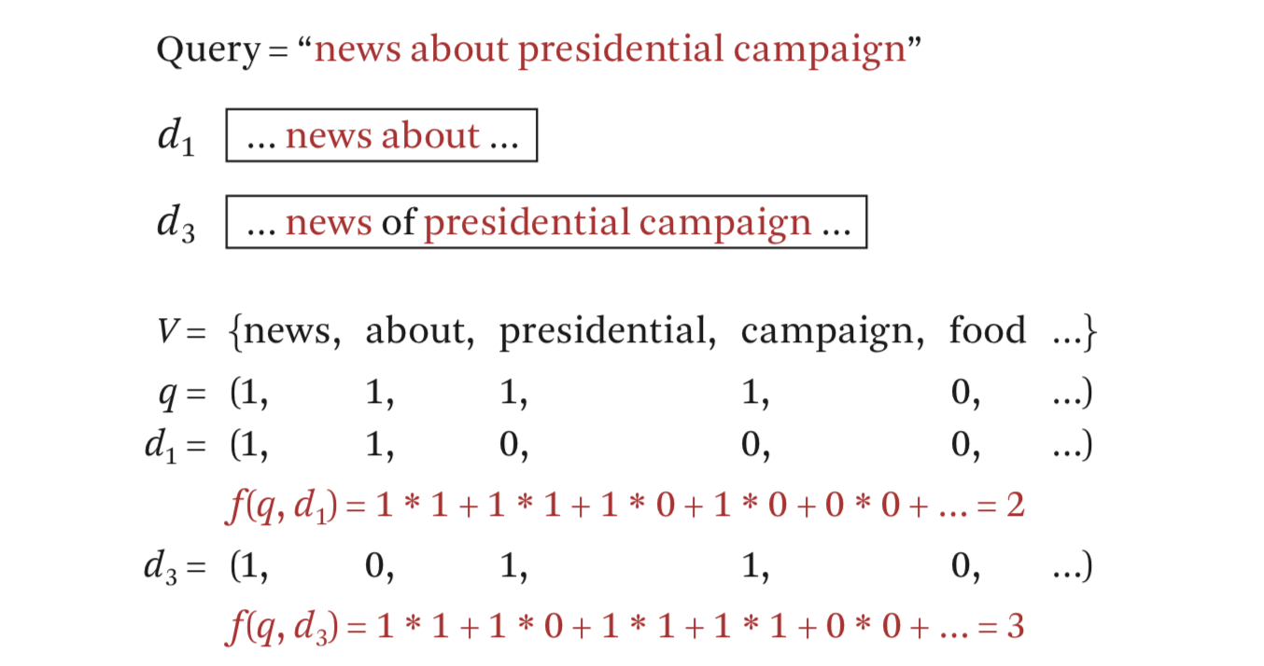
Bit Vector Representation
1: 关键字存在 0: 关键字不存在

Slide 30
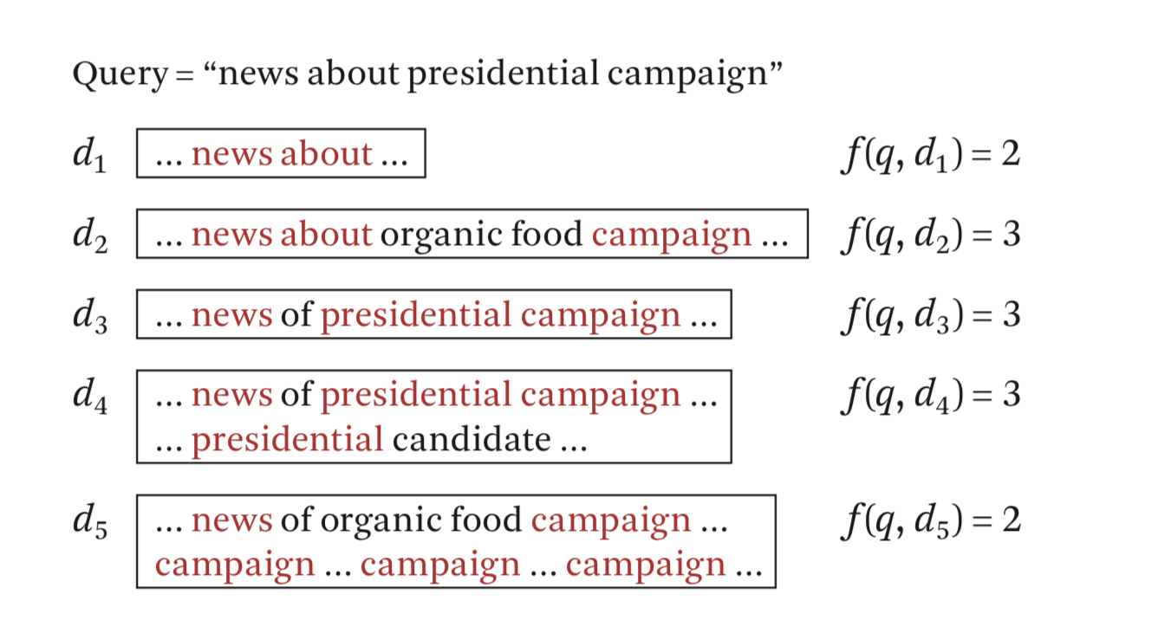
出现的问题：d2==d3==d4

Slide 31
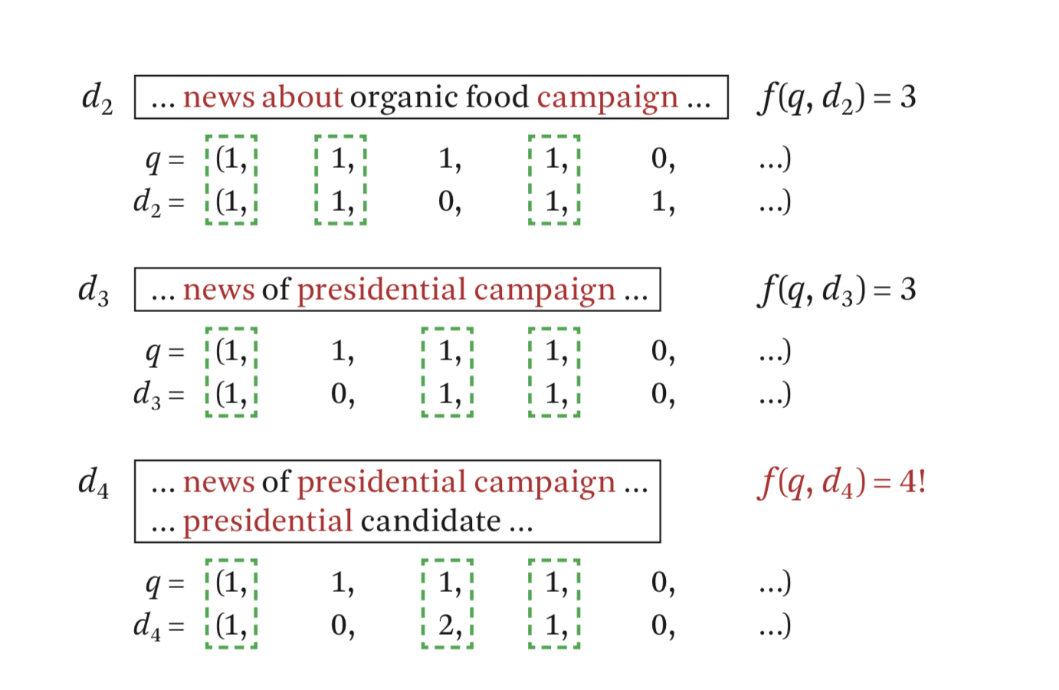
加入关键词出现的频率

Slide 32
出现的问题：d2==d3

Slide 33
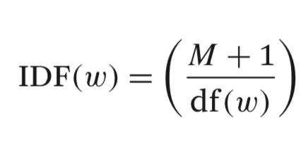
加入idf ：（inverse document frequency ）
M : 所有文件的数量
df(.) : 存在关键字的文档数量

Slide 34
Penalize common words which generally have a low IDF and reward informative words that have a higher IDF
惩罚IDF值低的字，奖励IDF值高的字

Slide 35
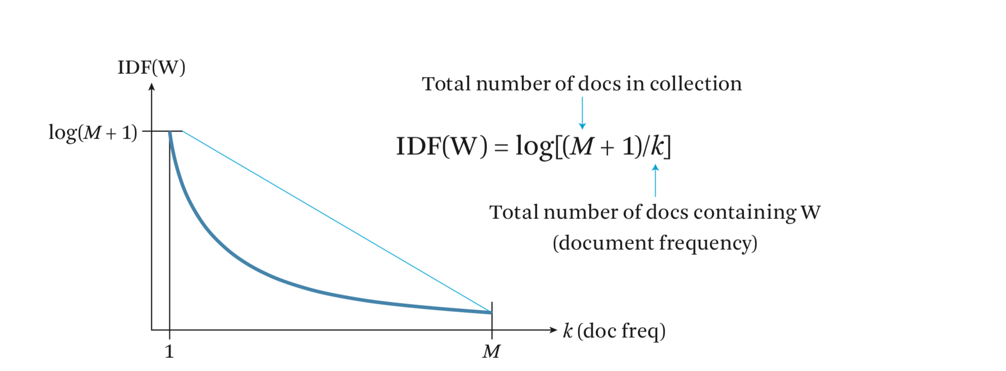

Slide 36
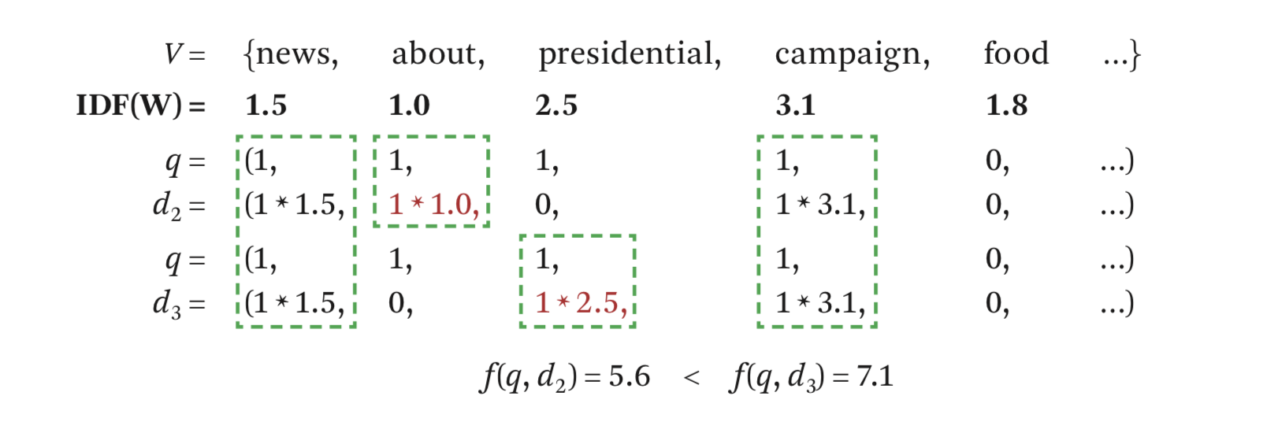

Slide 37
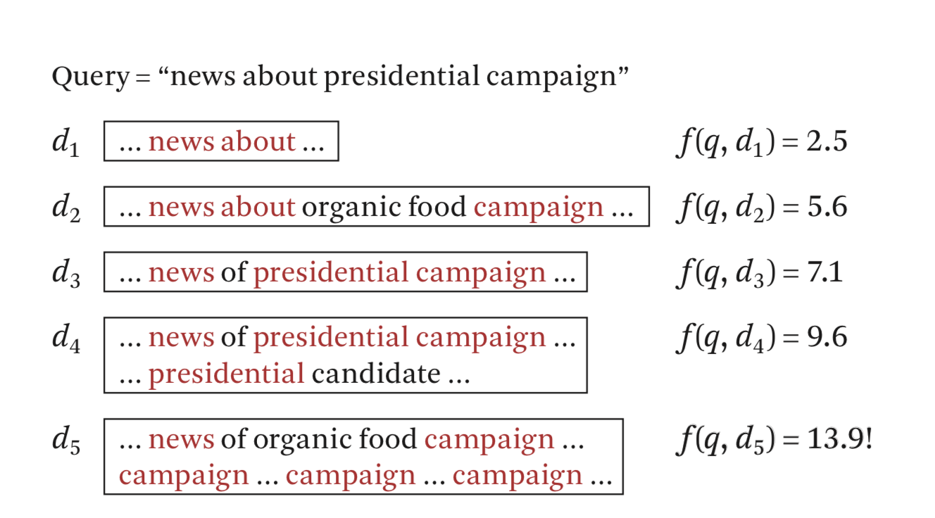
新的问题：d5相关性不大却得到了很高的值

Slide 38
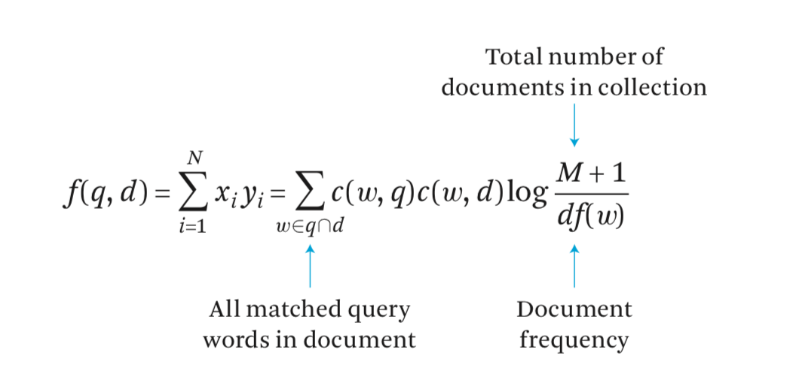
A ranking function
c(w, q) the count of the query term w in the query
c(w, d) the count of w in the document

Slide 39
Next ：Document Length Normalization 文章长度标准化

Slide 40
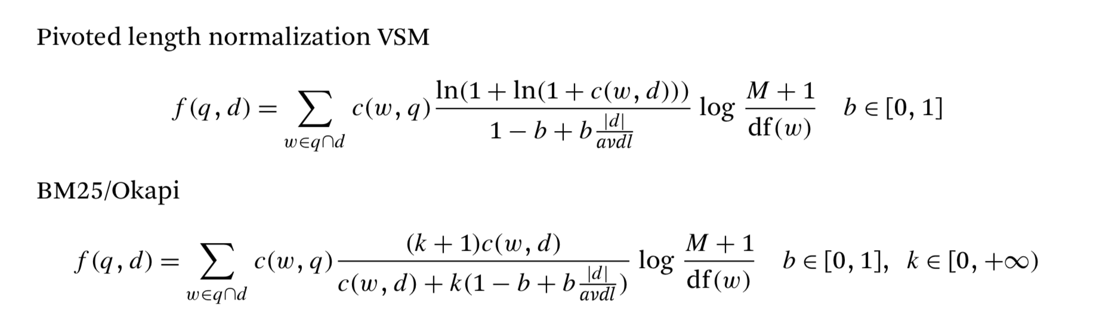

Slide 43
Data mining 数据挖掘

Slide 44
Interdisciplinary subject
Knowledge discovery from data

Slide 45
Difference between data mining and information retrieval

Slide 46
Information retrieval (IR) is the science of searching for documents or information in documents. Documents can be text or multimedia, and may reside on the Web. The differences between traditional information retrieval and database systems are twofold: Information retrieval assumes that (1) the data under search are unstructured; and (2) the queries are formed mainly by keywords, which do not have complex structures (unlike SQL queries in database systems).

Slide 47
1. Data cleaning (to remove noise and inconsistent data)

Slide 48
2. Data integration (where multiple data sources may be combined)

Slide 49
3. Data selection (where data relevant to the analysis task are retrieved from the database)

Slide 50
4.Data transformation (where data are transformed and consolidated into forms appropriate for mining by performing summary or aggregation operations)

Slide 51
5.Data mining (an essential process where intelligent methods are applied to extract data patterns)

Slide 52
6.Pattern evaluation (to identify the truly interesting patterns representing knowledge based on interestingness measures.

Slide 53
7.Knowledge presentation (where visualization and knowledge representation techniques are used to present mined knowledge to users)

Slide 54
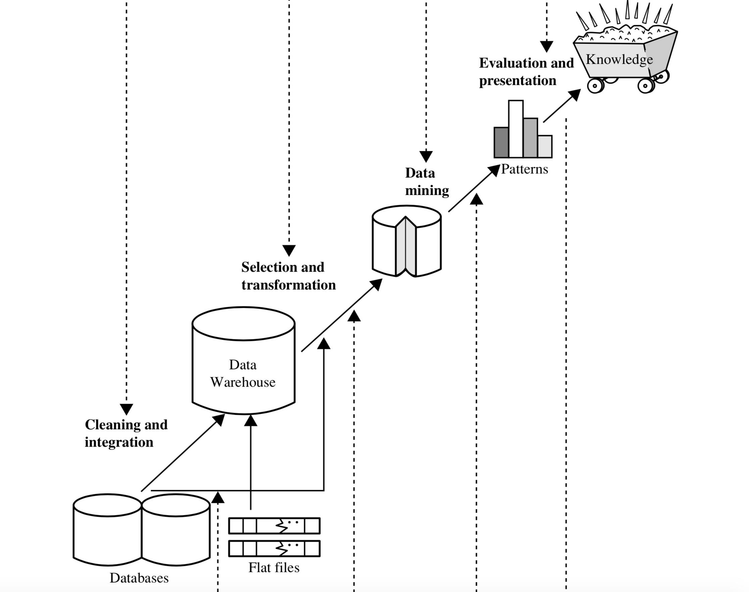

Slide 56
Recommender system 推荐系统

Slide 57
内容过滤(content based filtering)
协同过滤(collaborative filtering)

Slide 58
内容过滤：
根据个人喜好进行推荐，不考虑其他用户

Slide 59
协同过滤：
根据其他用户进行推荐
假定条件：
具有相同爱好的用户喜好相近
喜好相近的用户具有相同的兴趣

Slide 60
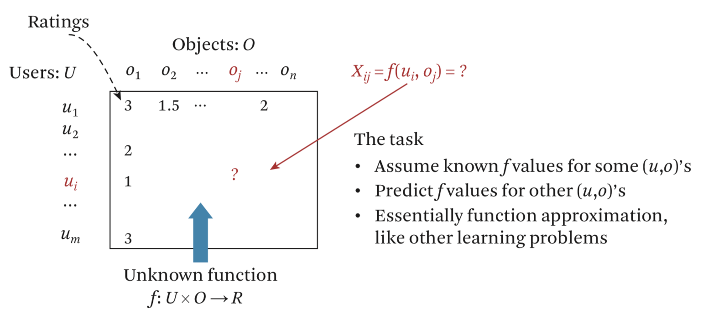

Slide 61
A -> 1112121111173911
1 -> A
B == A
B -> 2222223452222222
2 -> A

Slide 62
今日头条推荐算法

Slide 63
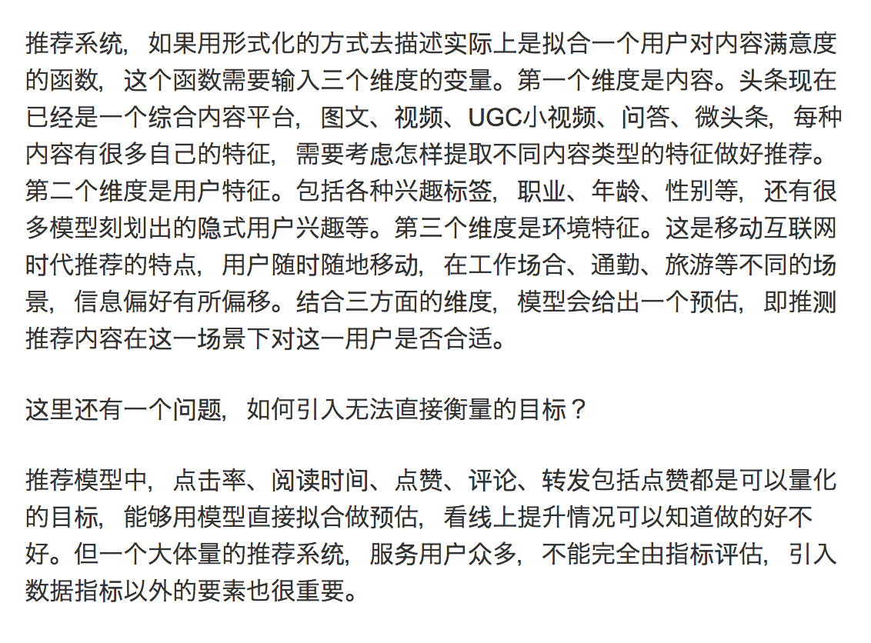

Slide 64
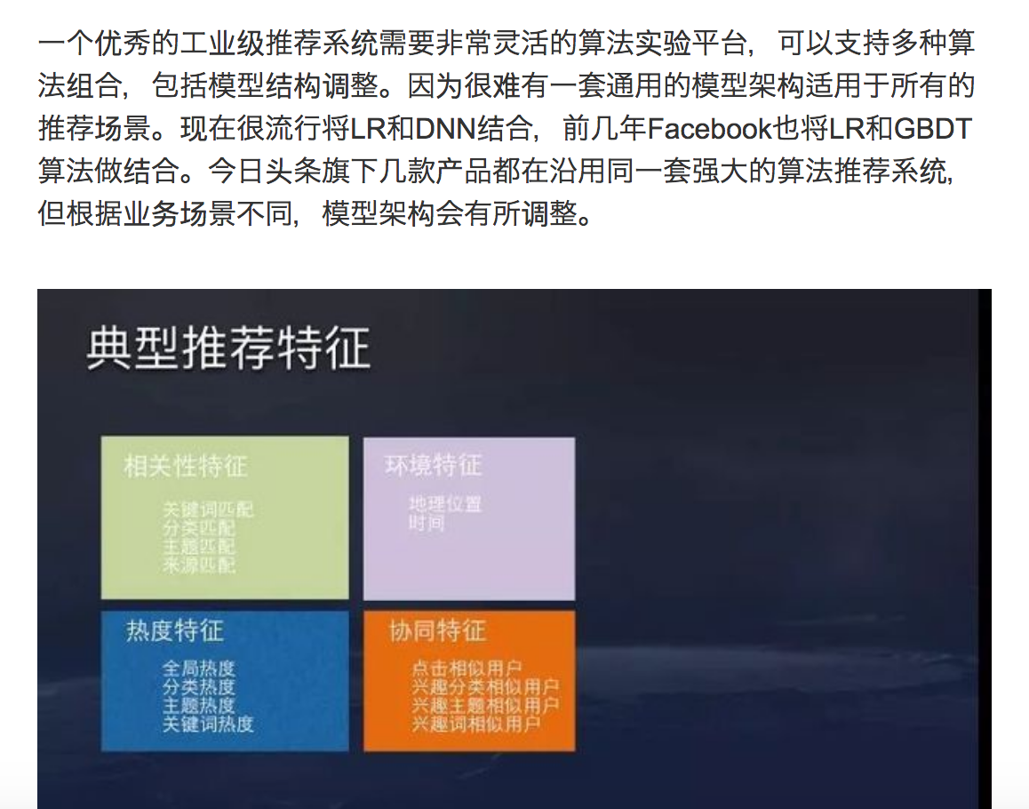

Slide 65
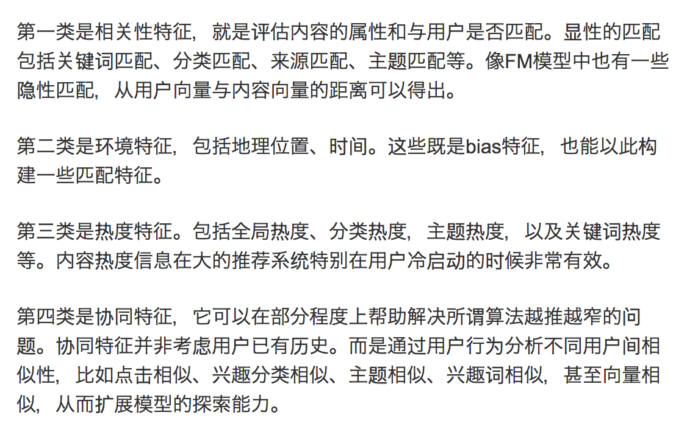

Slide 67
Natural language processing 自然语言处理

Slide 73
Computer vision 计算机视觉

Slide 76
VOICE RECOGNITION
语音识别

Slide 80
Reinforcement learning 强化学习

Slide 81
强化学习是机器学习中的一个领域，强调如何基于环境而行动，以取得最大化的预期利益。
---维基百科

Slide 82
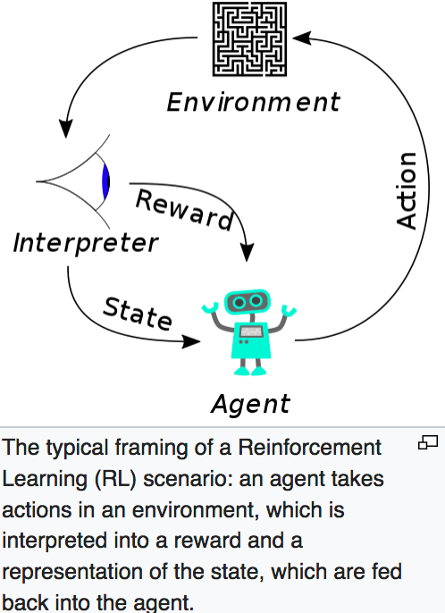

Slide 85
DEEP LEARNING AND NEURAL NETWORK
深度学习和神经网络

